Slide 1
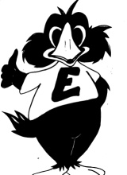
PBIS: Where Are We NOW? Where Are We HEADED?
Emily Hill
Kelly McCrohan
Edgewood Elementary
PBIS Coaches

Slide 2
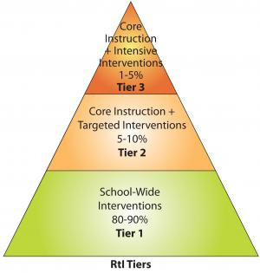
Our Need for PBIS
During the 2009-2010 school year, began collecting behavioral data in the form of major office referrals, also known as blue slips.
This data collection began in November.
At the end of the 09-10 school year, we had 418 major office referrals recorded.
At the end of the 10-11 school year, we had 392 major office referrals recorded.
The highest number of referrals
were as a result of disrespect both years.

Slide 3
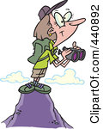
The Beginning…
On May 27, 2010, a team from SERC came and evaluated to what extent our school was implementing a school-wide positive behavioral interventions and supports. They did this using the School Evaluation Tool (SET).
At the time of the SET, we had not introduced the school-wide PBIS program to Edgewood.
SERC consultants spoke with staff and students about how well our school defined expectations, taught expectations, rewarded students, responded to situations, monitored students, made decisions, received support from the district, and managed our school’s behavior.

Slide 4
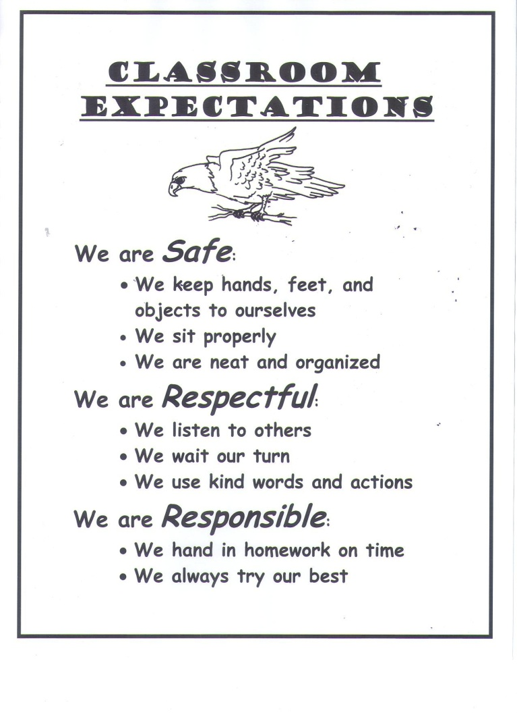
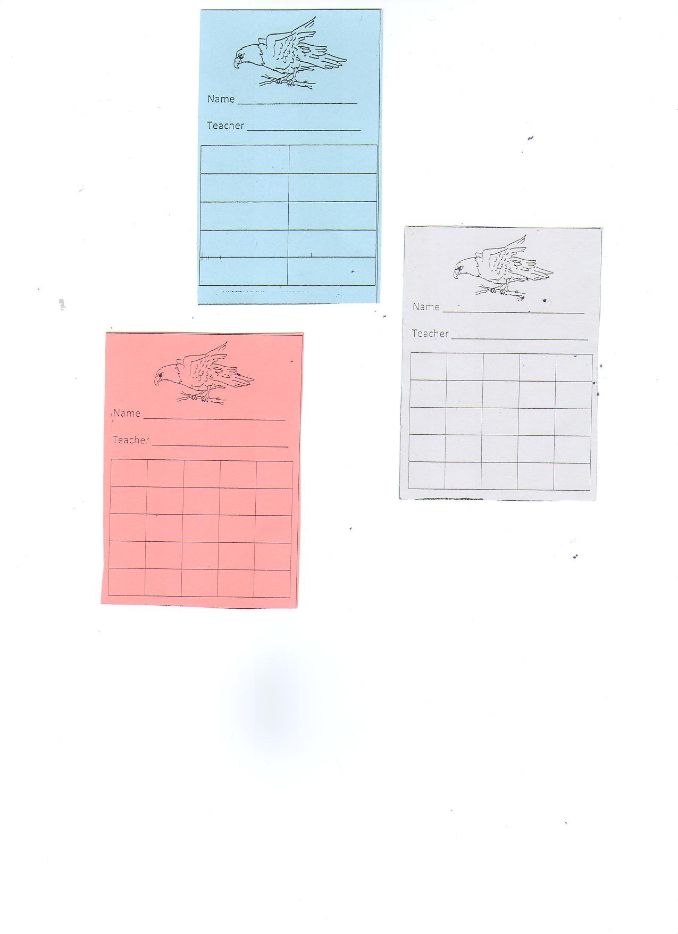
Tier I Intervention Overview
Three years ago we rolled out our Tier I school-wide behavior plan using the universal color system, expectations, eagle charts, and tickets.
All students earn positive reinforcement for staying on green all day and for above and beyond behavior.
Positive reinforcement comes in the form of verbal praise, tickets and signatures on students’ eagle charts, and ultimately prizes.

Slide 5
The Results from SET…
SET Data 2009-2010
What does this mean?
SERC looks for schools to have a score of a 90 in two areas: Expectations Taught and Total Mean.
If schools have a 90/90, they have implemented the program correctly and can become a “model school”.
At the time, without implementing/rolling out PBIS, we had a score of 60/76.

Slide 6
SET results from 2010-2011
SET Data 2010-2011
What does this mean…
SERC looks for schools to have a score of a 90 in two areas: Expectations Taught and Total Mean.
If schools have a 90/90, they have implemented the program correctly and can become a “model school”.
For the 2010-2011 school year we had 90/99

Slide 7
SET results from 2011-2012
SET Data 2011-2012
What does this mean…
For the 2011-2012 school year we had
SERC looks for schools to have a score of a 90 in two areas: Expectations Taught and Total Mean.
If schools have a 90/90, they have implemented the program correctly and can become a “model school”.
For the 2011-2012 school year we had 100/91

Slide 8
Behavioral Data Comparison
For the 2011-2012 school year, we collected behavioral data all year long.
Our numbers are up from 392 referrals to 455 referrals. This is an increase of 63 referrals.
 | 2009-2010 School Year (November- June) | 2010-2011 School Year | 2011-2012 School Year
Number of Major Office Referrals | 418 | 392 | 455

Slide 9
Month by Month Behavioral Data Comparison
Month | 2009- 2010 | 2010- 2011 | 2011- 2012
September | - | 30 | 37
October | - | 18 | 51
November | 21 | 27 | 39
December | 73 | 28 | 59
January | 74 | 34 | 44
February | 45 | 39 | 46
March | 76 | 62 | 69
April | 49 | 57 | 32
May | 69 | 60 | 60
June | 11 | 37 | 18

Slide 10
PBIS Triangle Data Report 2010-2011
88% of our students have 0-1 referrals.
78% of our students have 0 referrals.
7% of our students have 2-5 referrals.
5% of our students have 6 or more referrals.
Of the 3%, 1.75% have more then 9 referrals.

Slide 11
PBIS Triangle Data Report 2011-2012
88% of our students have 0-1 referrals.
77.5% of our students have 0 referrals.
6% of our students have 2-5 referrals.
6% of our students have 6 or more referrals.

Slide 12
PBIS Triangle Data Report 2012-2013
85.5% of our students have 0-1 referrals.
73.25% of our students have 0 referrals.
8.5% of our students have 2-5 referrals.
6% of our students have 6 or more referrals.

Slide 13
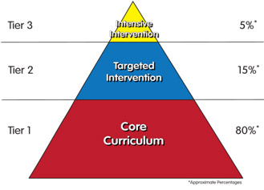
Tier II
Our Tier I intervention resulted in 85.5% of our students with 0-1 office referrals; this is above expectations of 80% success.
However, we know that not all of our students have been successful at Tier I; some of their behavioral needs are greater.
During the 2011-2012 school year, our team rolled out a Tier II program to support the needs of some of these students.
This program is be called the High Five Program, and is modeled after a Check-in-Check-out (CICO) system.

Slide 14
What is the High-Five Program?
The High Five Program is a means to respond positively to students who need extra support with their behavior. Some students require more instruction and support to self-regulate their behavior and require extra adult support as they learn to do so.
The High Five Program provides extra reinforcement and positive attention from adults. These adults will be known as our High Five mentors. The High Five Program also provides for daily communication between a student and his/her teacher and between the mentor and the student’s parents. In addition, data is collected to determine whether the program is successful or whether changes need to be made.

Slide 15
The High Five Program Allows Students to…
 | 9:00-10:00 | 10:00-11:00 | 11:00-12:00 | 12:00-1:00 | 1:00-2:00 | 2:00-3:00
Be Safe | 0 1 2 | 0 1 2 | 0 1 2 | 0 1 2 | 0 1 2 | 0 1 2
Be Respectful | 0 1 2 | 0 1 2 | 0 1 2 | 0 1 2 | 0 1 2 | 0 1 2
Be Responsible | 0 1 2 | 0 1 2 | 0 1 2 | 0 1 2 | 0 1 2 | 0 1 2
Total Points
Teacher Initials
Check in with a mentor at the beginning of the school day.
Carry a tracking behavior form (High Five Chart).
Ask their classroom teacher to rate their behavior and provide immediate feedback.
Check out at the end of each school day with their mentor.
Earn a ticket for each day they meet their goal.
Take their High Five Chart home to parents to sign.
Return the signed High Five Chart the next morning.
 | 9:00-10:00 | 10:00-11:00 | 11:00-12:00 | 12:00-1:00 | 1:00-2:00 | 2:00-3:00
Be Safe | ☺ 😐 ☹ | ☺ 😐 ☹ | ☺ 😐 ☹ | ☺ 😐 ☹ | ☺ 😐 ☹ | ☺ 😐 ☹
Be Respectful | ☺ 😐 ☹ | ☺ 😐 ☹ | ☺ 😐 ☹ | ☺ 😐 ☹ | ☺ 😐 ☹ | ☺ 😐 ☹
Be Responsible | ☺ 😐 ☹ | ☺ 😐 ☹ | ☺ 😐 ☹ | ☺ 😐 ☹ | ☺ 😐 ☹ | ☺ 😐 ☹
Total Points
Teacher Initials

Slide 16
Who would make a GOOD Candidate for the High-Five-Program?
It is important to remember that not all students who have needs above the Tier I program will be good candidates for Tier II.
Students in the High Five Program have the skills to follow our school expectations but need encouragement.
These students also enjoy adult/peer attention.
By looking at data, these are the students with 2-5 office referrals (about 7% of our population).
**It is important to note that NOT ALL students with behavioral needs above and beyond the school wide program will be High-Five candidates. **

Slide 17
High Five Data from 2011-2012
In the 2011-2012 year, we rolled out High-Five Program
We had 4 dedicated mentors
21 students were recommended for the program.
We received 19 signed permission slips.
At this time, 37% of these students were on track to meet grade level expectations in reading.
During the year we had 10 students graduate from the program.
We currently have 13 students in the program.
Presently, 60% of our students are at or above grade level in reading as measured by grade level expectation.
75% of our students decreased their number of Office Discipline Referrals (ODRs) this year.
We have new recommendations for the 2012-2013 school year.

Slide 18
Important Notes
Students, parents, and teachers are required to sign off on participation into the program. Fidelity checks will be done to make sure all members are participating.
Without full participant buy-in the program cannot be successful.
Teachers who nominate students for the program MUST BE committed to completing their daily charts on an hourly basis with brief feedback during this time.
Staff and parents are welcome to and can nominate students at any time for the program, but the ultimate decision comes from the PBIS behavior-team.

Slide 19
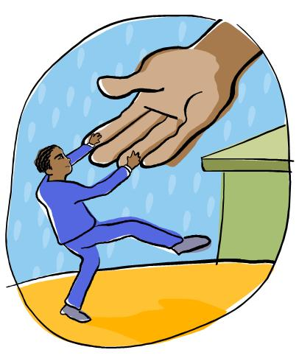
Other Tier II Interventions/Supports at Edgewood School…
High-Five Program
Bully Prevention counseling groups
Lunch Bunch groups
Literacy Groups
RSVP Volunteers
Mentors

Slide 20
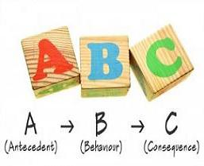
Tier III Interventions
Functional Behavioral Assessments (FBAs)
Behavior Intervention Plans (BIPs)
Individualized counseling services
Special Education Services

Slide 21
Thank You!
These programs would not have been successful without everyone’s participation, enthusiasm, and buy-in.
The pay-off has been huge, let’s keep the programs successful!
Keep up the hard work and REMEMBER TO STAY POSITIVE! ☺

